Slide 1
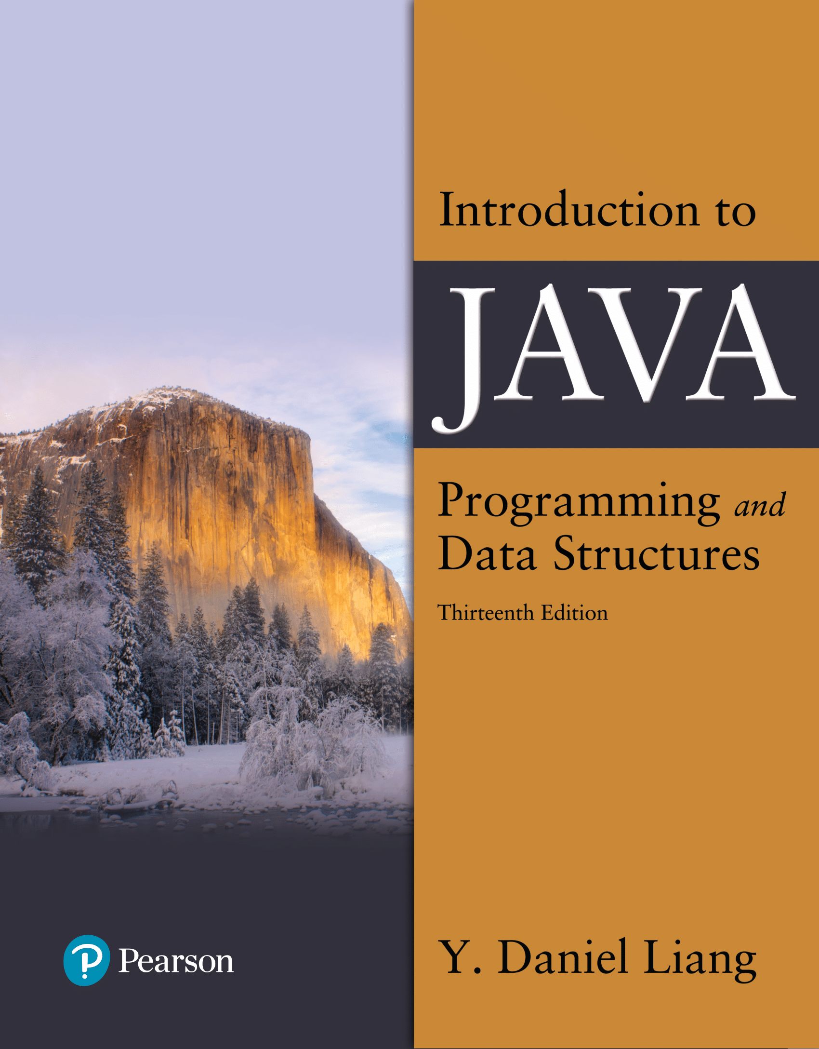

Introduction to Java Programming and Data Structures
Thirteenth Edition
Chapter 7
Single-Dimensional Arrays
Copyright © 2024 Pearson Education, Inc. All Rights Reserved
Notes:
If this PowerPoint presentation contains mathematical equations, you may need to check that your computer has the following installed:
1) MathType Plugin
2) Math Player (free versions available)
3) NVDA Reader (free versions available)
Slides in this presentation contain hyperlinks. JAWS users should be able to get a list of links by using INSERT+F7

Slide 2
Opening Problem
Read one hundred numbers, compute their average, and find out how many numbers are above the average.

Slide 3
Objectives (1 of 2)
7.1 To describe why arrays are necessary in programming (§7.1).
7.2 To declare array reference variables and create arrays (§§7.2.1–7.2.2).
7.3 To obtain array size using arrayRefVar.length and know default values in an array (§7.2.3).
7.4 To access array elements using indexes (§7.2.4).
7.5 To declare, create, and initialize an array using an array initializer (§7.2.5).
7.6 To program common array operations (displaying arrays, summing all elements, finding the minimum and maximum elements, random shuffling, and shifting elements) (§7.2.6).
7.7 To simplify programming using the foreach loops (§7.2.7).

Slide 4
Objectives (2 of 2)
7.8 To apply arrays in application development (AnalyzeNumbers, DeckOfCards) (§§7.3–7.4).
7.9 To copy contents from one array to another (§7.5).
7.10 To develop and invoke methods with array arguments and return values (§§7.6–7.8).
7.11 To define a method with a variable-length argument list (§7.9).
7.12 To search elements using the linear (§7.10.1) or binary (§7.10.2) search algorithm.
7.13 To sort an array using the selection sort approach (§7.11).
7.14 To use the methods in the java.util.Arrays class (§7.12).
7.15 To pass arguments to the main method from the command line (§7.13).

Slide 5
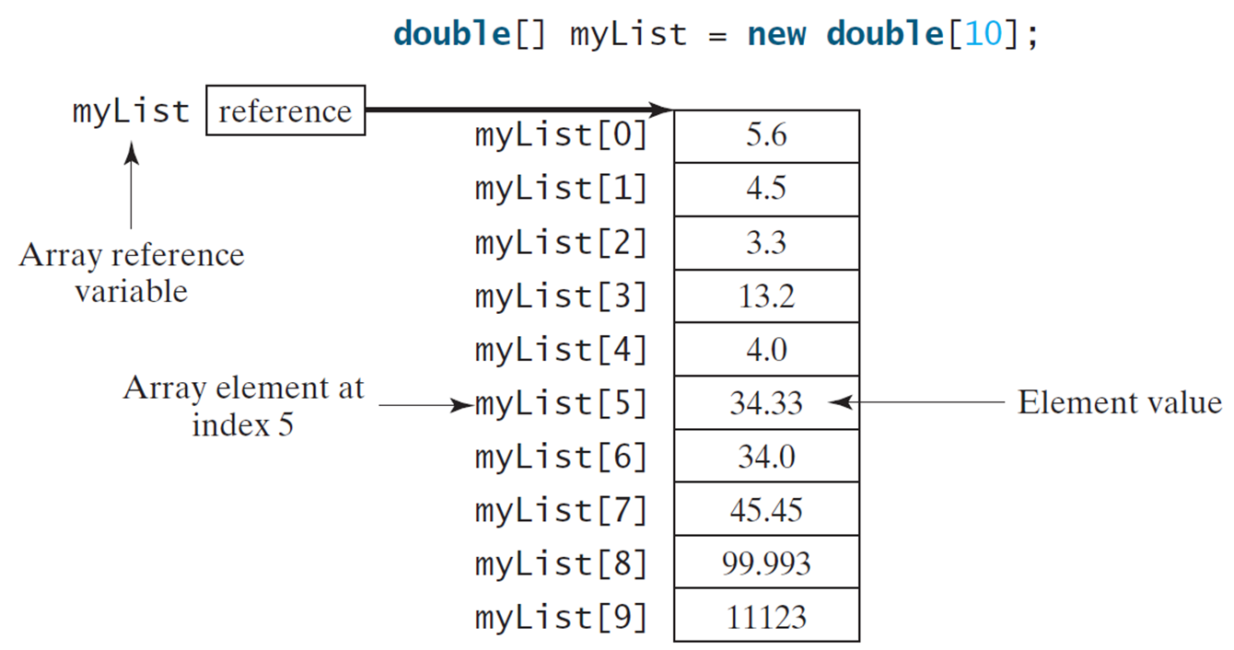
Introducing Arrays
Array is a data structure that represents a collection of the same types of data.
Notes:
The list of arrays is labeled as Array element at index 5. My list is labeled as Array reference variable, with an Element value against each array variable.
Array list, Element value
my list open bracket 0 close bracket, 5.6
my list open bracket 1 close bracket, 4.5
my list open bracket 2 close bracket, 3.3
my list open bracket 3 close bracket, 13.2
my list open bracket 4 close bracket, 4.0
my list open bracket 5 close bracket, 34.33
my list open bracket 6 close bracket, 34.0
my list open bracket 7 close bracket, 45.45
my list open bracket 8 close bracket, 99.993
my list open bracket 9 close bracket, 11123

Slide 6
Declaring Array Variables
datatype[] arrayRefVar;
Example:
double[] myList;
datatype arrayRefVar[]; // This style is allowed, but not preferred
Example:
double myList[];

Slide 7
Creating Arrays
arrayRefVar = new datatype[arraySize];
Example:
myList = new double[10];
myList[0] references the first element in the array.
myList[9] references the last element in the array.

Slide 8
Declaring and Creating in One Step
datatype[] arrayRefVar = new datatype[arraySize];
double[] myList = new double[10];
datatype arrayRefVar[] = new datatype[arraySize];
double myList[] = new double[10];

Slide 9
The Length of an Array
Once an array is created, its size is fixed. It cannot be changed. You can find its size using
arrayRefVar.length
For example,
myList.length returns 10

Slide 10
Default Values
When an array is created, its elements are assigned the default value of
0 for the numeric primitive data types,
'\u0000' for char types, and
false for boolean types.

Slide 11
Indexed Variables
The array elements are accessed through the index. The array indices are 0-based, i.e., it starts from 0 to arrayRefVar.length-1. In the example in Figure 6.1, myList holds ten double values and the indices are from 0 to 9.
Each element in the array is represented using the following syntax, known as an indexed variable:
arrayRefVar[index];

Slide 12
Using Indexed Variables
After an array is created, an indexed variable can be used in the same way as a regular variable. For example, the following code adds the value in myList[0] and myList[1] to myList[2].
myList[2] = myList[0] + myList[1];

Slide 13
Array Initializers
Declaring, creating, initializing in one step:
double[] myList = {1.9, 2.9, 3.4, 3.5};
This shorthand syntax must be in one statement.

Slide 14
Declaring, Creating, Initializing Using the Shorthand Notation
double[] myList = {1.9, 2.9, 3.4, 3.5};
This shorthand notation is equivalent to the following statements:
double[] myList = new double[4];
myList[0] = 1.9;
myList[1] = 2.9;
myList[2] = 3.4;
myList[3] = 3.5;

Slide 15
CAUTION
Using the shorthand notation, you have to declare, create, and initialize the array all in one statement. Splitting it would cause a syntax error. For example, the following is wrong:
double[] myList;
myList = {1.9, 2.9, 3.4, 3.5};

Slide 16
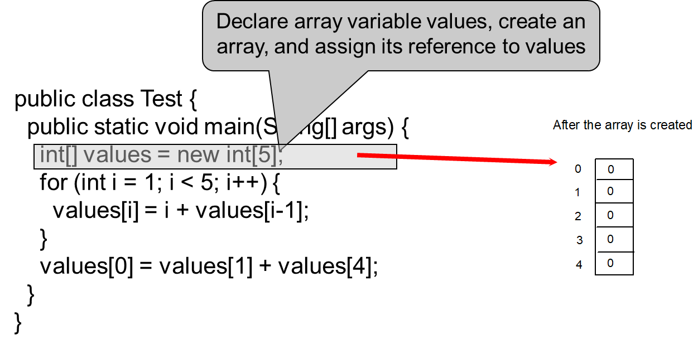
Trace Program with Arrays (1 of 16)
Notes:
create an array, and assign its reference to values, points to the text, int open and close brackets values = new int open bracket 5 close bracket. The text is also connected to an array created in a column. The array reads,
0, 0
1, 0
2, 0
3, 0
4, 0

Slide 17
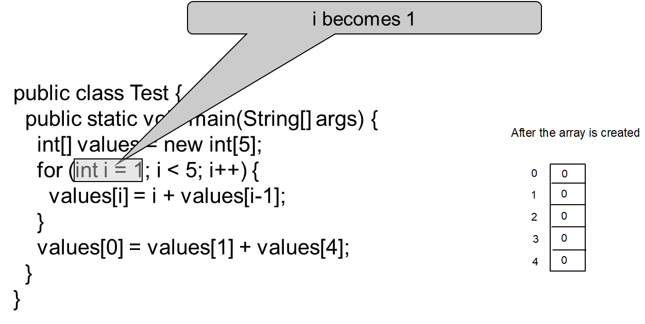
Trace Program with Arrays (2 of 16)

Slide 18
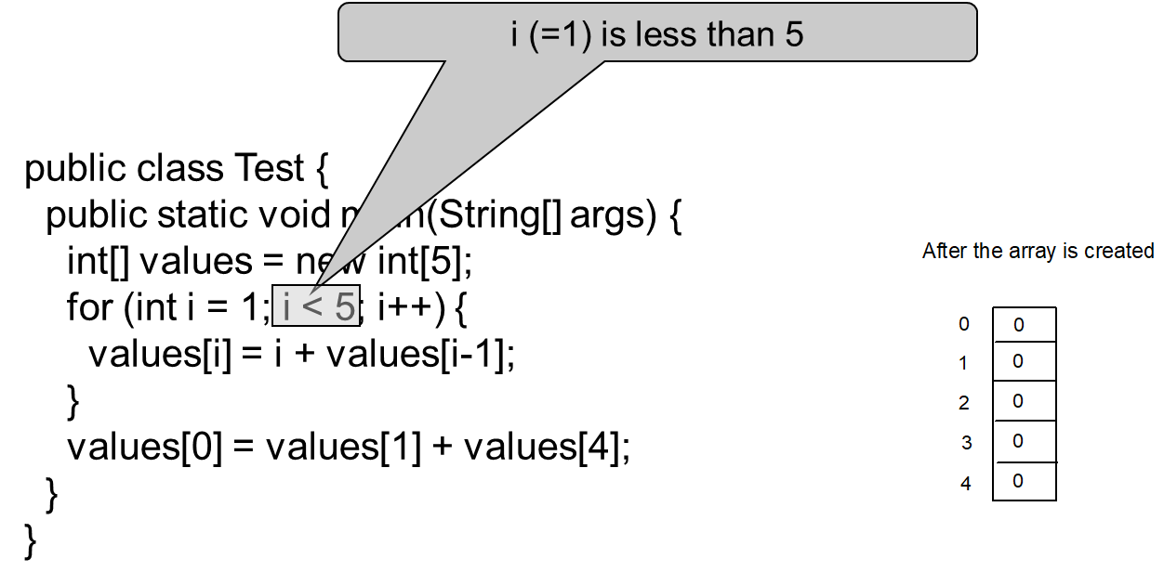
Trace Program with Arrays (3 of 16)

Slide 19
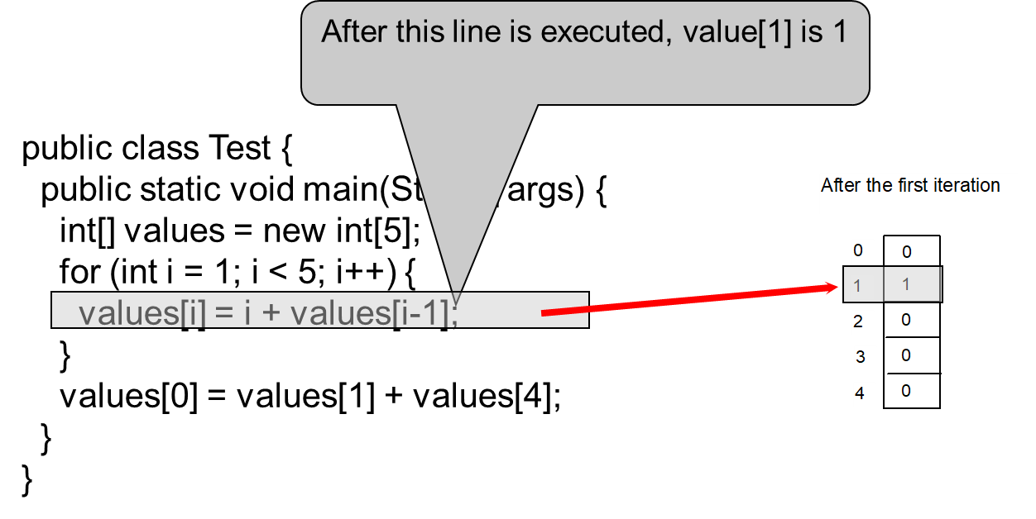
Trace Program with Arrays (4 of 16)
Notes:
value open bracket 1 close bracket is 1, points to the text, values open bracket i close bracket = i + values open bracket i minus 1 close bracket. An arrow from the text points to a column array, with the title After the first iteration. The array has the following information,
0, 0
1, 0
2, 0
3, 0
4, 0
The arrow points to 1, 0.

Slide 20
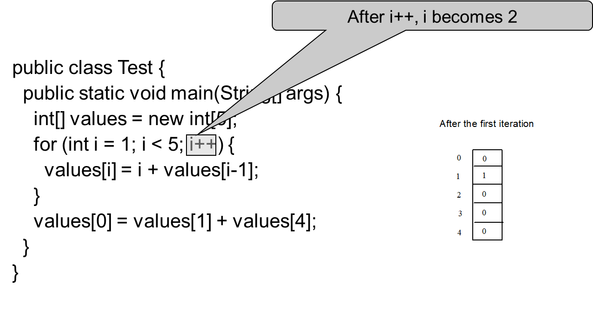
Trace Program with Arrays (5 of 16)

Slide 21
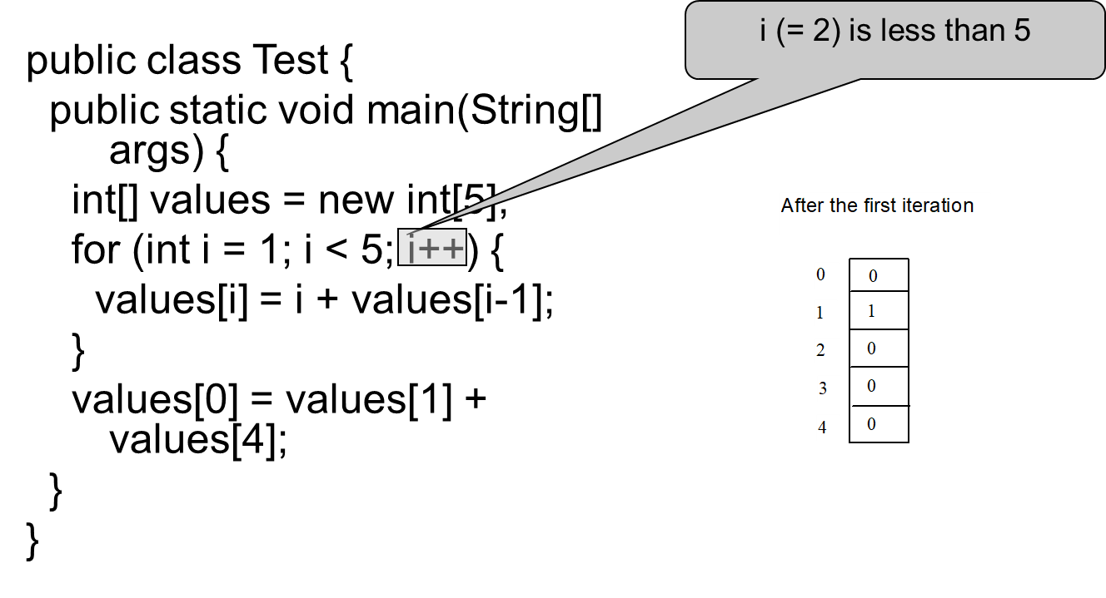
Trace Program with Arrays (6 of 16)

Slide 22
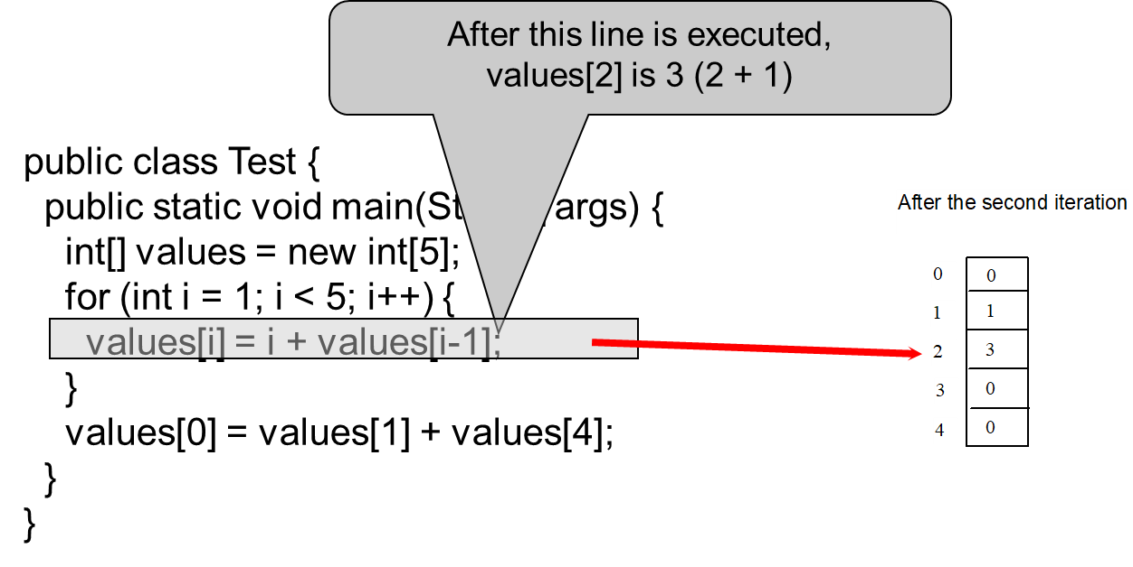
Trace Program with Arrays (7 of 16)
Notes:
values open bracket 2 close bracket is 3 open parenthesis 2 + 1 close parenthesis, points to the text, values open bracket i close bracket = i + values open bracket i minus 1 close bracket. An arrow from the text points to 2, 3 in a column array, titled After the second iteration.

Slide 23
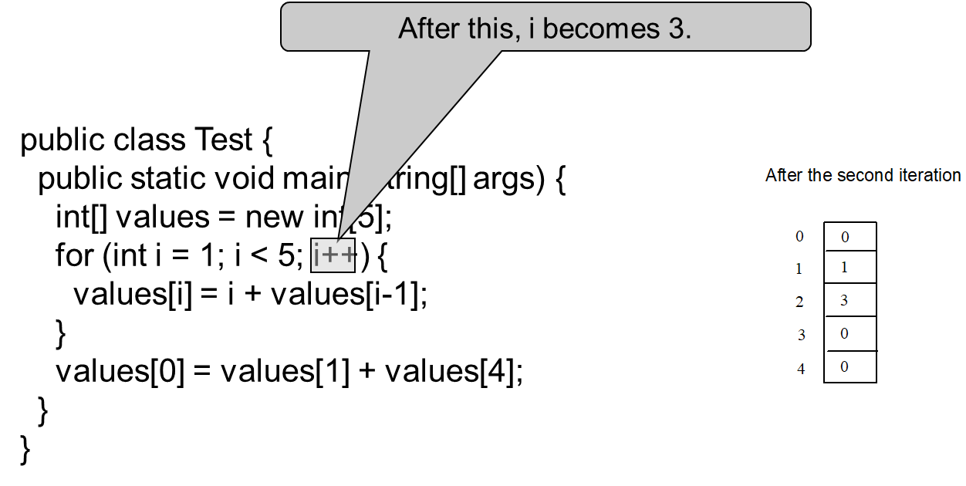
Trace Program with Arrays (8 of 16)

Slide 24
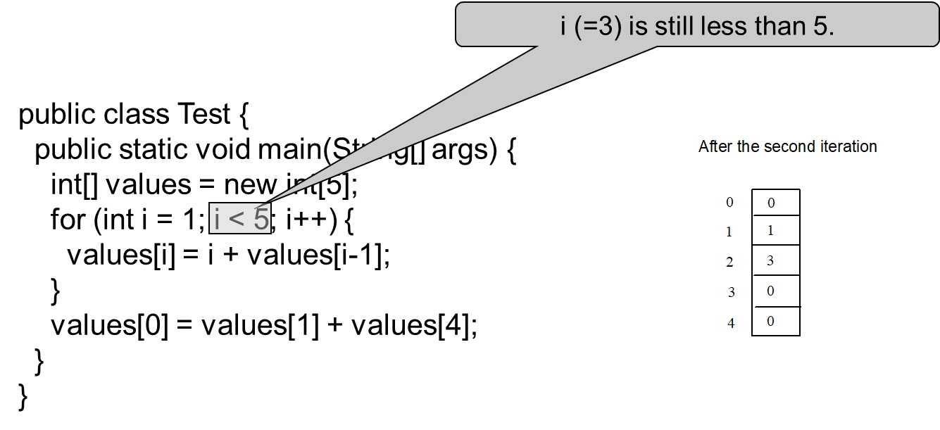
Trace Program with Arrays (9 of 16)

Slide 25
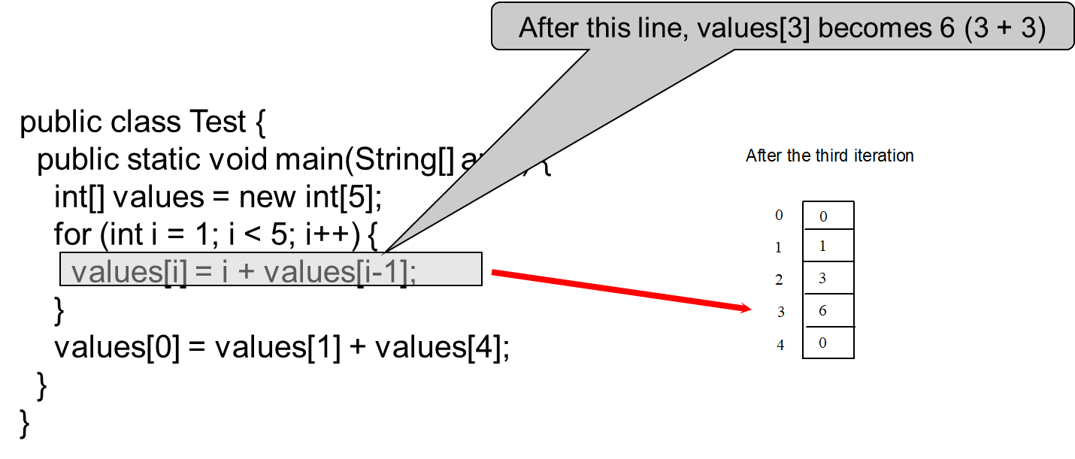
Trace Program with Arrays (10 of 16)
Notes:
values open bracket 3 close bracket becomes 6 open parenthesis 3 + 3 close parenthesis, points to the text, values open bracket i close bracket = i + values open bracket i minus 1 close bracket. An arrow from the text points to 3, 6 that is a part of a column array.

Slide 26
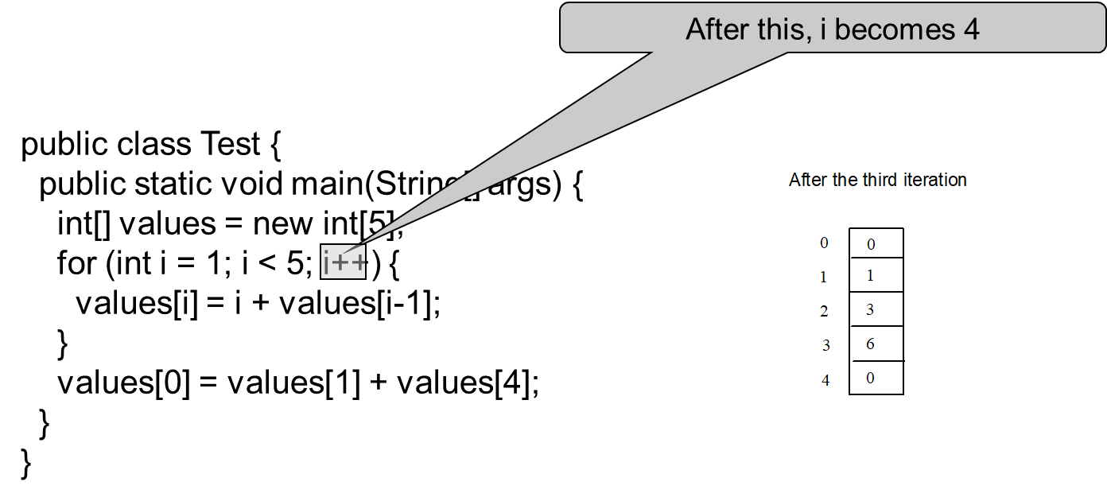
Trace Program with Arrays (11 of 16)

Slide 27
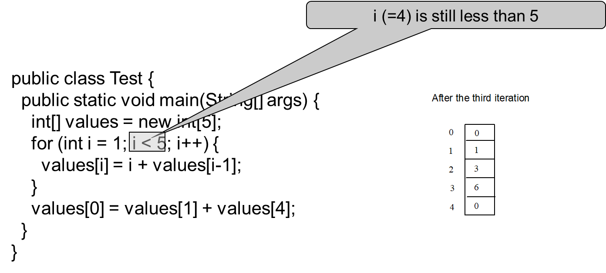
Trace Program with Arrays (12 of 16)

Slide 28
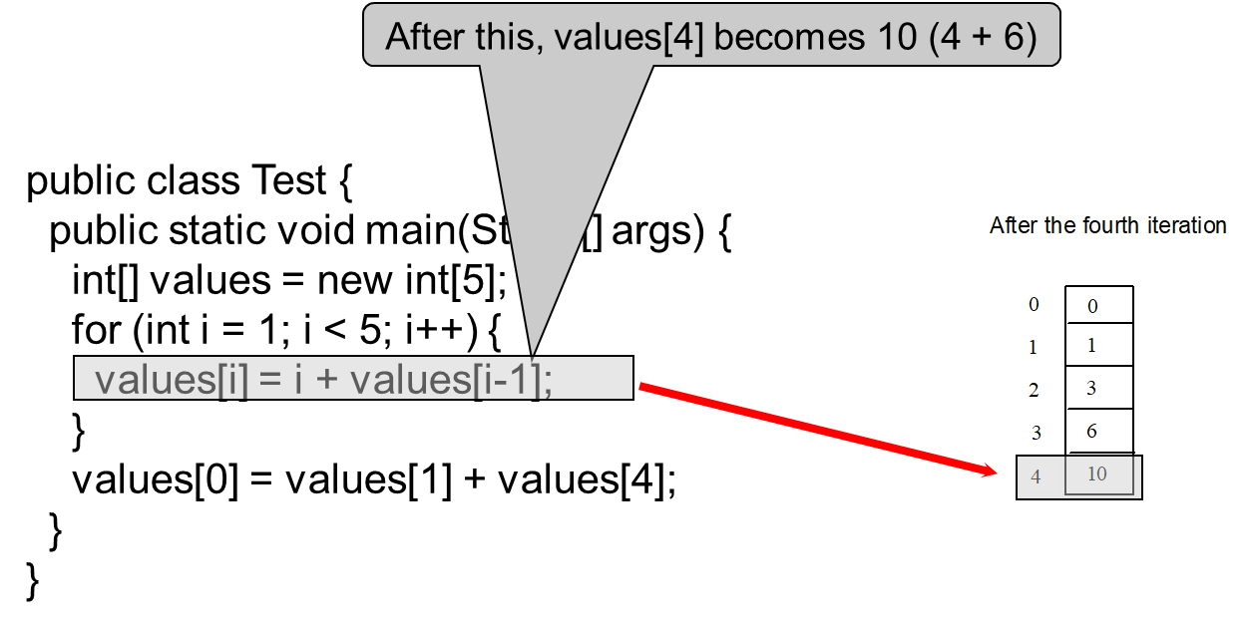
Trace Program with Arrays (13 of 16)
Notes:
values open bracket 4 close bracket becomes 10 open parenthesis 4 + 6 close parenthesis, points to the text, values open bracket i close bracket = i + values open bracket i minus 1 close bracket. An arrow from the text points to 4, 10 that is a part of a column array, titled After the fourth iteration.

Slide 29
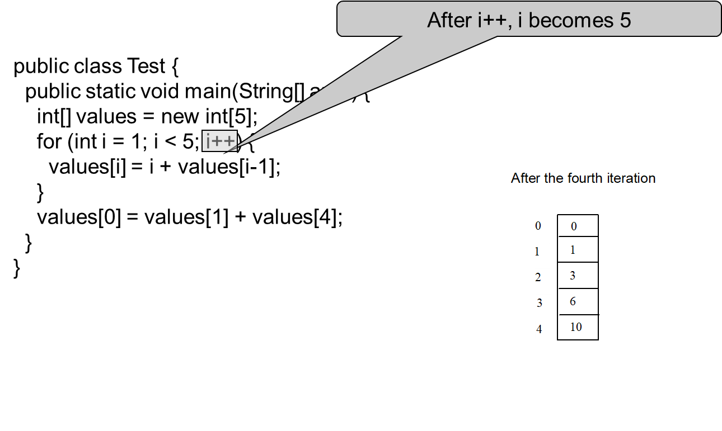
Trace Program with Arrays (14 of 16)

Slide 30
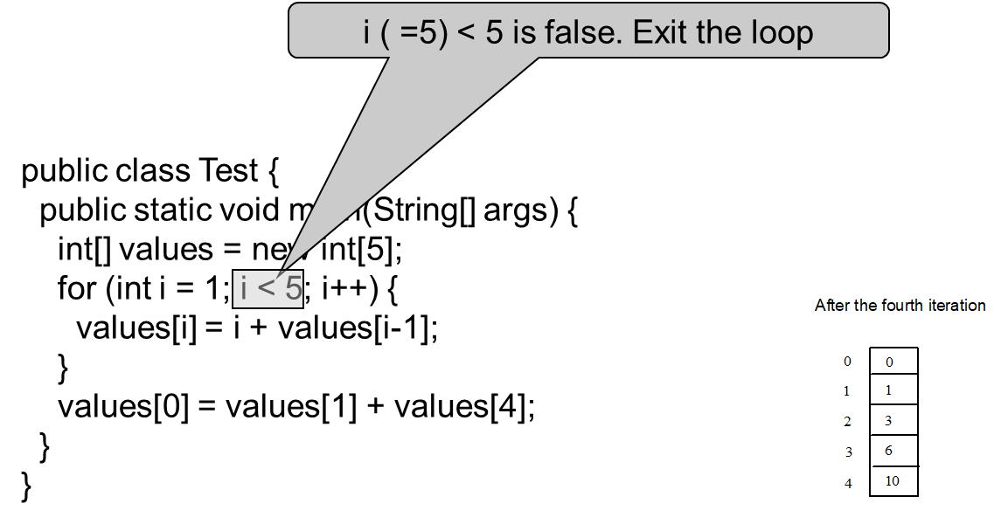
Trace Program with Arrays (15 of 16)

Slide 31
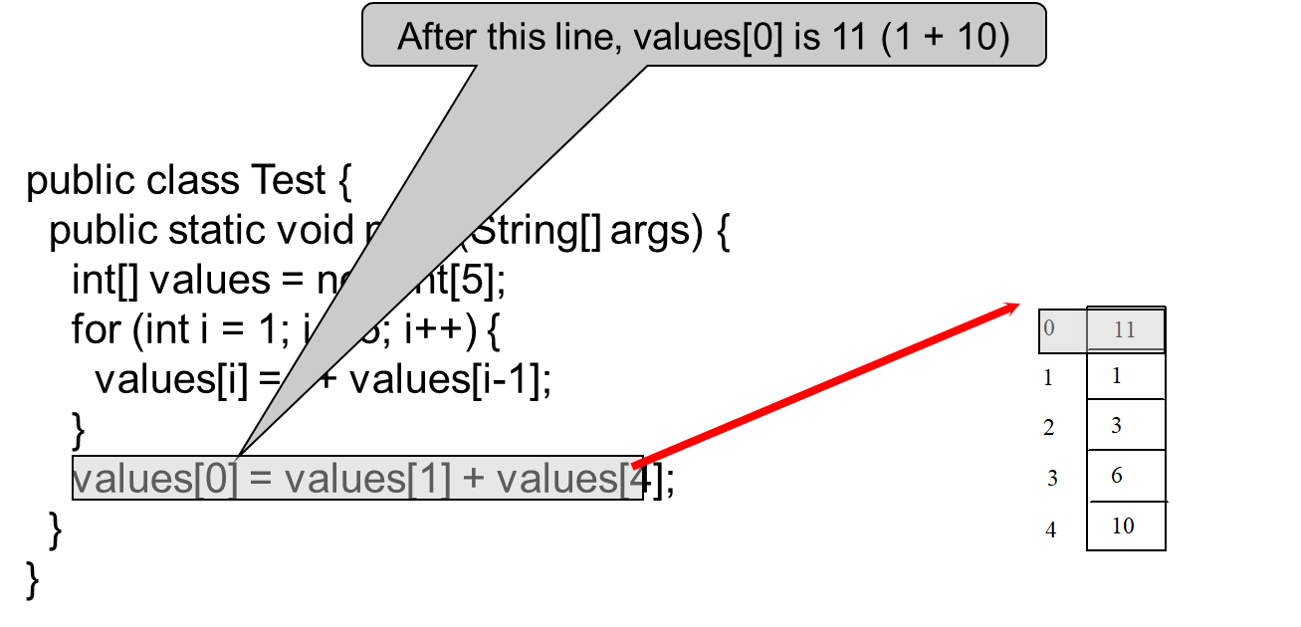
Trace Program with Arrays (16 of 16)
Notes:
values open bracket 0 close bracket is 11 open parenthesis 1 + 10 close bracket, points to the text, values open bracket 0 close bracket = values open bracket 1 close bracket + values open bracket 4 close bracket. An arrow from the text points to 0, 11, that is a part of a column array.

Slide 32
Processing Arrays
See the examples in the text.
(Initializing arrays with input values)
(Initializing arrays with random values)
(Printing arrays)
(Summing all elements)
(Finding the largest element)
(Finding the smallest index of the largest element)
(Random shuffling)
(Shifting elements)

Slide 33
Enhanced for Loop (for-each loop)
J D K 1.5 introduced a new for loop that enables you to traverse the complete array sequentially without using an index variable. For example, the following code displays all elements in the array myList:
for (double value: myList)
System.out.println(value);
In general, the syntax is
for (elementType value: arrayRefVar) {
// Process the value
}
You still have to use an index variable if you wish to traverse the array in a different order or change the elements in the array.

Slide 34
Analyze Numbers
Read one hundred numbers, compute their average, and find out how many numbers are above the average.
AnalyzeNumbers
Notes:
AnalyzeNumbers: https://liveexample.pearsoncmg.com/html/AnalyzeNumbers.html

Slide 35
Problem: Deck of Cards (1 of 4)
The problem is to write a program that picks four cards randomly from a deck of 52 cards. All the cards can be represented using an array named deck, filled with initial values 0 to 51, as follows:
int[] deck = new int[52];
// Initialize cards
for (int i = 0; i < deck.length; i++)
deck[i] = i;
DeckOfCards
Notes:
DeckOfCards: https://liveexample.pearsoncmg.com/html/DeckOfCards.html

Slide 36
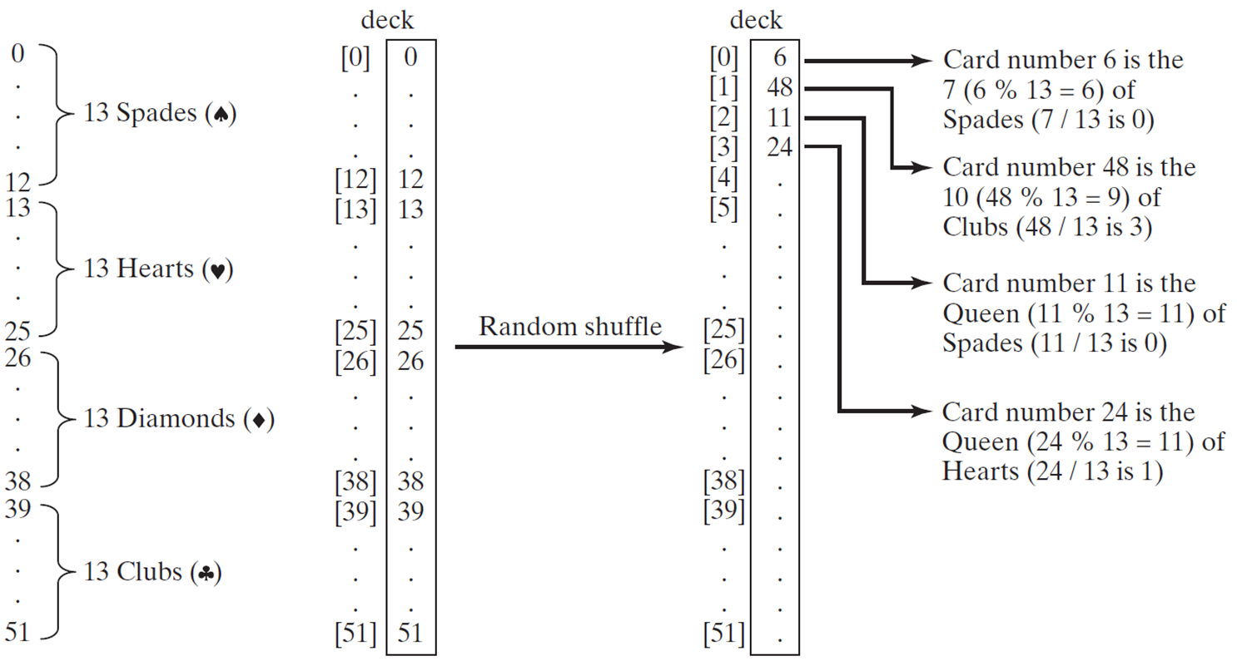
Problem: Deck of Cards (2 of 4)
Notes:
The first column shows 0, vertical ellipses, 12 combined together as 13 spades. The column further goes down to 13, vertical ellipses, 25, combined together as 13 hearts. Going down further the column to 26, vertical ellipses, 38, combined together as 13 diamonds. The last part of this column is from 39, vertical ellipses to 51, combined together as 13 clubs.
The second column shows deck as open bracket 0 close bracket, 0, vertical ellipses, open bracket 12, 12, open bracket 13 close bracket, vertical ellipses, open bracket 25 close bracket, 25, open bracket 26 close bracket, vertical ellipses, open bracket 38 close bracket, open bracket 39 close bracket, vertical ellipses open bracket 51 close bracket.
The third column shows a deck
open bracket 0 close bracket, 6, labeled with Card number 6 is the 7 open parenthesis 6 % 13 = 6 close parenthesis of spades open parenthesis 7 over 13 is 0.
Open bracket 1 close bracket, 48, labeled as Card number 48 is the 10 open parenthesis 48 % 13 = 9 close parenthesis of clubs open parenthesis 48 over 13 is 3 close parenthesis.
Open bracket 2 close bracket, 11 is labeled as Card number 11 is the queen open parenthesis 11 % 13 = 11 close parenthesis of spades open parenthesis 11 over 13 is 0 close parenthesis.
open parenthesis 3 close parenthesis, 24 is labeled as Card number 24 is the queen open parenthesis 24 % 13 = 11 close parenthesis of hearts open parenthesis 24 over 13 is 1 close parenthesis.
Vertical ellipses.
An arrow points from second column to third column. The arrow is labeled as Random shuffle.

Slide 37
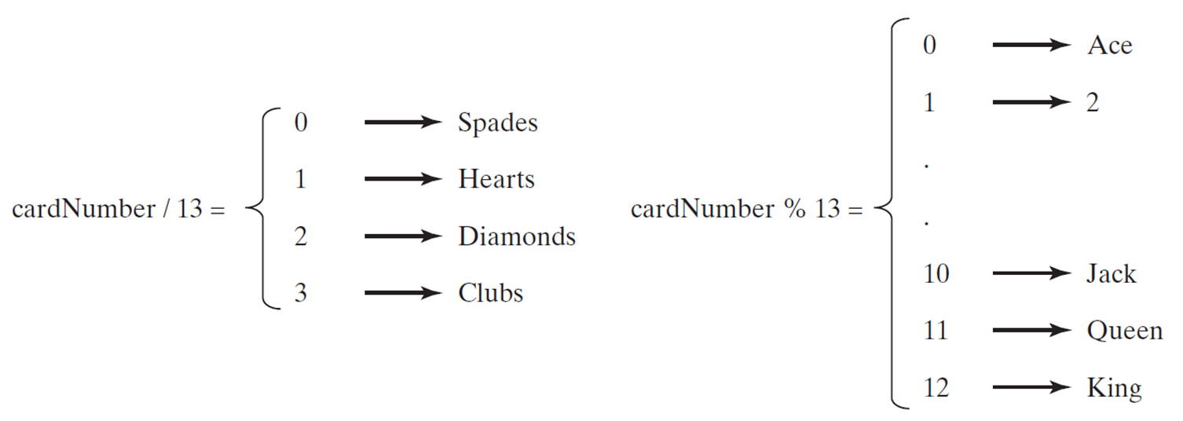
Problem: Deck of Cards (3 of 4)
DeckOfCards
Notes:
DeckOfCards: https://liveexample.pearsoncmg.com/html/DeckOfCards.html

Slide 38
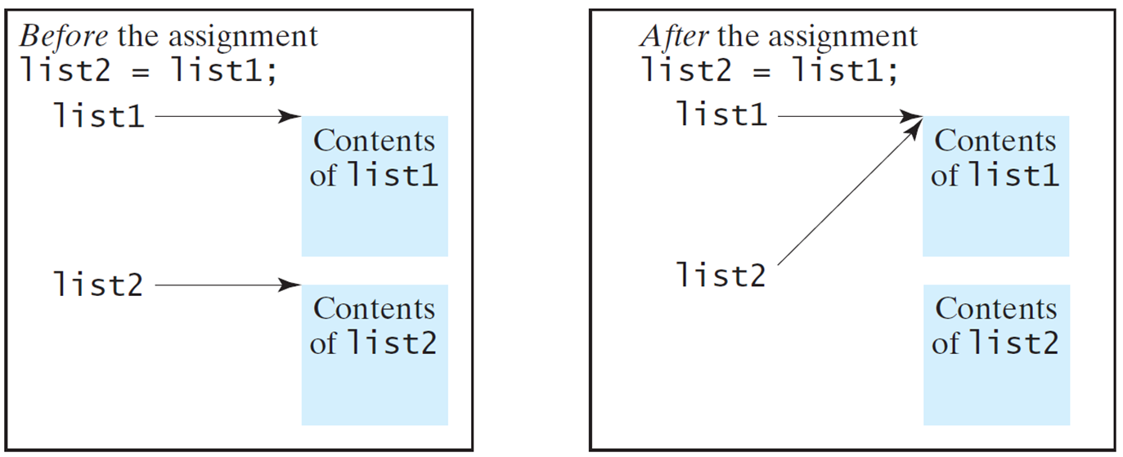
Copying Arrays (1 of 2)
Often, in a program, you need to duplicate an array or a part of an array. In such cases you could attempt to use the assignment statement (=), as follows:
list2 = list1;

Slide 39
Copying Arrays (2 of 2)
Using a loop:
int[] sourceArray = {2, 3, 1, 5, 10};
int[] targetArray = new int[sourceArray.length];
for (int i = 0; i < sourceArrays.length; i++)
targetArray[i] = sourceArray[i];

Slide 40
The arraycopy Utility
arraycopy(sourceArray, src_pos, targetArray, tar_pos, length);
Example:
System.arraycopy(sourceArray, 0, targetArray, 0, sourceArray.length);

Slide 41
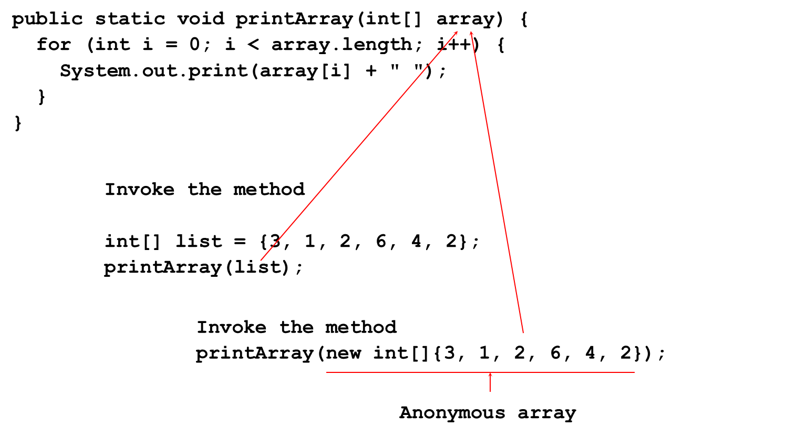
Passing Arrays to Methods
Notes:
Public static void print Array open parenthesis int open and close brackets array close parenthesis open brace for open parenthesis int i = 0; i less than array. Length; i plus plus close parenthesis open brace System.out.print open parenthesis array open bracket i close bracket plus open double quotes close double quotes close parenthesis;
Invoke the method
int open and close brackets list = open brace 3, 1, 2, 6, 4, 2 close brace; print Array open parenthesis list close parenthesis. Invoke the method print Array open parenthesis new int open and close brackets open brace 3, 1, 2, 6, 4, 2 close brace close parenthesis. The numbers are labeled as Anonymous array. array in the first line is connected to print Array open parenthesis list close parenthesis. Array in the first line is also connected to anonymous array in the last line.

Slide 42
Anonymous Array
The statement
printArray(new int[]{3, 1, 2, 6, 4, 2});
creates an array using the following syntax:
new dataType[]{literal0, literal1, ..., literalk};
There is no explicit reference variable for the array. Such array is called an anonymous array.

Slide 43
Pass By Value
Java uses pass by value to pass arguments to a method. There are important differences between passing a value of variables of primitive data types and passing arrays.
For a parameter of a primitive type value, the actual value is passed. Changing the value of the local parameter inside the method does not affect the value of the variable outside the method.
For a parameter of an array type, the value of the parameter contains a reference to an array; this reference is passed to the method. Any changes to the array that occur inside the method body will affect the original array that was passed as the argument.

Slide 44
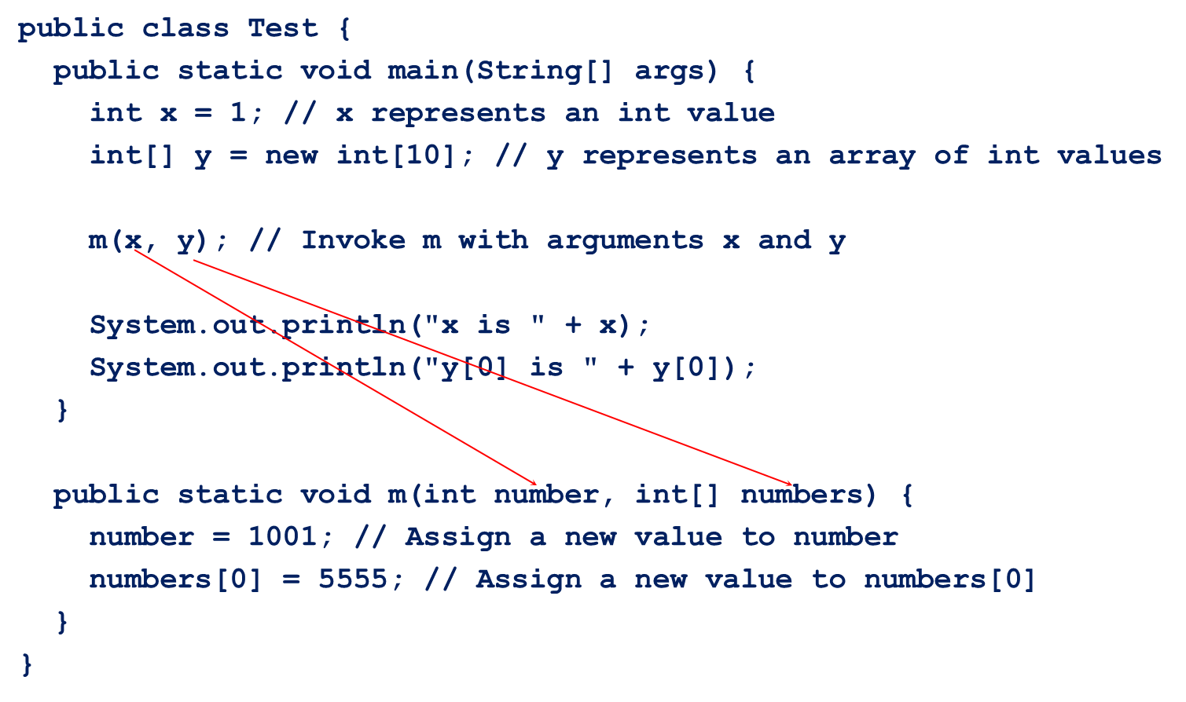
Simple Example

Slide 45
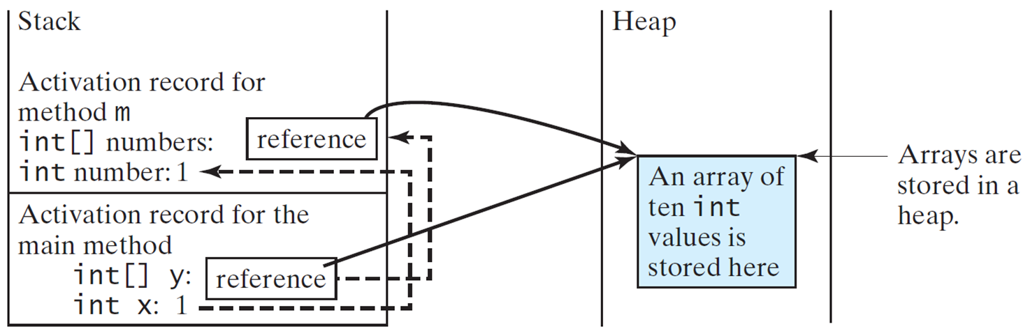
Call Stack (1 of 2)
When invoking m(x, y), the values of x and y are passed to number and numbers. Since y contains the reference value to the array, numbers now contains the same reference value to the same array.
Notes:
The stack on the left side is divided into two parts. The upper part has Activation record for method m int open and close brackets numbers, reference in a box.
Int number, 1. The lower part has Activation record for the main method int open and close brackets y, reference in a text box.
int x, 1. An arrow from here points to int number, 1 in the upper part. Another arrow points from reference in the lower part to reference in the upper part.
The stack on the right is labeled as Heap, depicting An array of ten int values is stored here. The box consisting of this text is labeled as, Arrays are stored in a heap. Arrows from both the reference boxes on the left point to the text box under Heap.

Slide 46
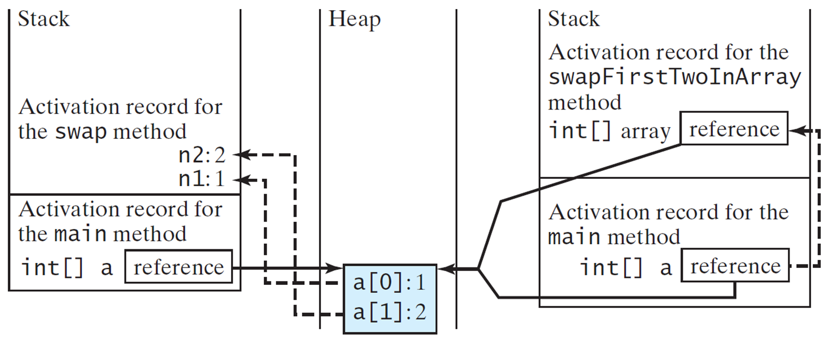
Call Stack (2 of 2)
When invoking m(x, y), the values of x and y are passed to number and numbers. Since y contains the reference value to the array, numbers now contains the same reference value to the same array.
Notes:
It shows five columns. The first column depicts Stack. The second and fourth columns are empty. The third column depicts Heap. The fifth column shows Stack.
Column 1, Stack. It is divided into two parts. The upper part shows Activation record for the Swap method, with n 2, 2, and n 1, 1.
Column 2, Empty.
Column 3, Heap, with a open bracket 0 close bracket, 1, and open bracket 1 close bracket, 2. An arrow from a open bracket 0 close bracket, 1 points to n 1, 1. Another arrow from a open bracket 1 close bracket, 2 points to n 2, 2.
Column 4, blank.
Column 5, Stack. The stack is divided into two parts. The upper part shows Activation record for the swap First two in array method int open and close brackets array. It also shows reference in a box. The lower part of stack reads, Activation record for the main method int open and close brackets a. It also shows reference in a box. An arrow points from refence in the lower stack to reference in the upper stack. Arrow from reference in both lower and upper parts point to the box depicting a open bracket 0 close bracket, 1, and a open bracket 1 close bracket, 2.

Slide 47
Heap
The J V M stores the array in an area of memory, called heap, which is used for dynamic memory allocation where blocks of memory are allocated and freed in an arbitrary order.
Notes:
The stack is divided into two parts. The upper part is blank. The lower part consists of Space required for the main method, with int open and close brackets y, reference inside a box, and int x, 1.
The heap consists of arrays, with 5555 on the top, with 0, blank, and 0 below it. 5555 is labeled as The arrays are stored in a heap. An arrow points from reference in a stack to 5555 in the heap.

Slide 48
Passing Arrays as Arguments
Objective: Demonstrate differences of passing primitive data type variables and array variables.
TestPassArray
Notes:
TestPassArray: https://liveexample.pearsoncmg.com/html/TestPassArray.html

Slide 49
Example
Notes:
Column 1. Stack. It is divided into two parts. The upper part consists of Space required for the swap method, with n 2, 2, and n 1, 1. The lower part consists of Space required for the main method, with int open and close brackets a, and reference in a box. Text below this column reads, Invoke swap open parenthesis int n 1, int n 2 close parenthesis. The primitive type values in a open bracket 0 close bracket and a open bracket 1 close bracket are passed to the swap method.
Column 2. Blank.
Column 3. Heap. A box consists of a open bracket 1 close bracket, 2. a open bracket 0 close bracket, 1. An arrow points from reference in Stack to the box in the heap column. An arrow points from a open bracket 1 close bracket, 2 in the heap column to n 2, 2 in the stack column. Another arrow points from a open bracket 0 close bracket, 1. Text below this column reads, The arrays are stored in a heap.
Column 4. Blank.
Column 5. Stack. The stack is divided into two parts. The text in the upper part reads, Space required for the swap First Two in Array method int open and close brackets array. It also shows the word, reference in a box. Text in the lower part reads, Space required for the main method, int open and close brackets a . It also shows the word, reference in a box. An arrow points from reference in the lower part to reference in the upper part. From both the words, reference, an arrow points to the box in heap column. Text below this column reads, Invoke swap First Two in Array open parenthesis int open and close bracket array close parenthesis. The reference value in a is passed to the swap First Two in Array method.

Slide 50
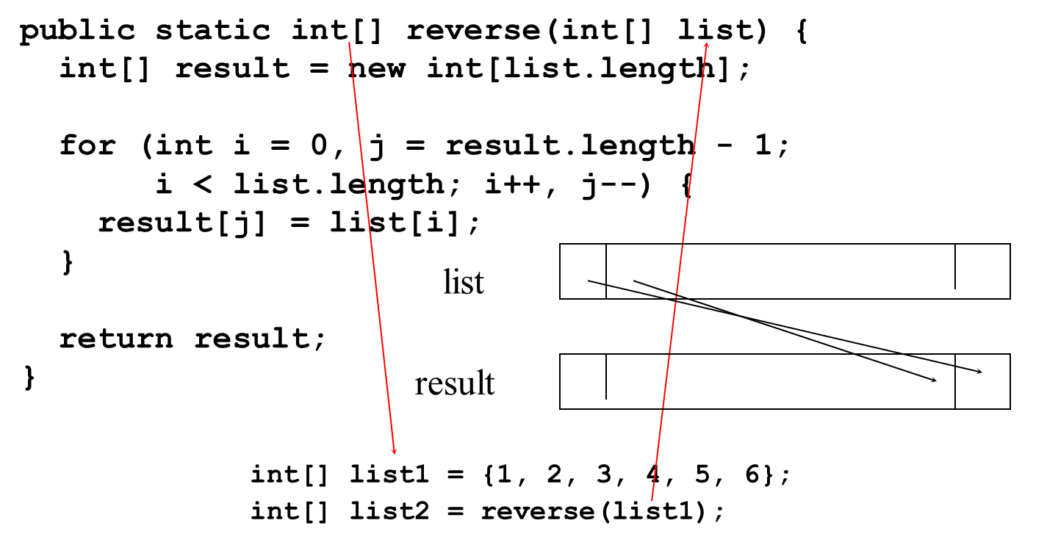
Returning an Array from a Method
Notes:
It shows two horizontal boxes with three columns each, connected to each other through two lines.
The first line of the array reads, public static int open and close brackets reverse open parenthesis int open and close brackets list close parenthesis open brace.
The second last line of the array reads, int open and close brackets list 1 = open brace 1, 2, 3, 4, 5, 6 close brace.
The last line of the array reads, int open and close brackets list 2 = reverse open parenthesis list 1 close parenthesis.
int in the first line is connected to list 1 in the second last line. list in the first line is connected to list 1 in the last line.

Slide 51
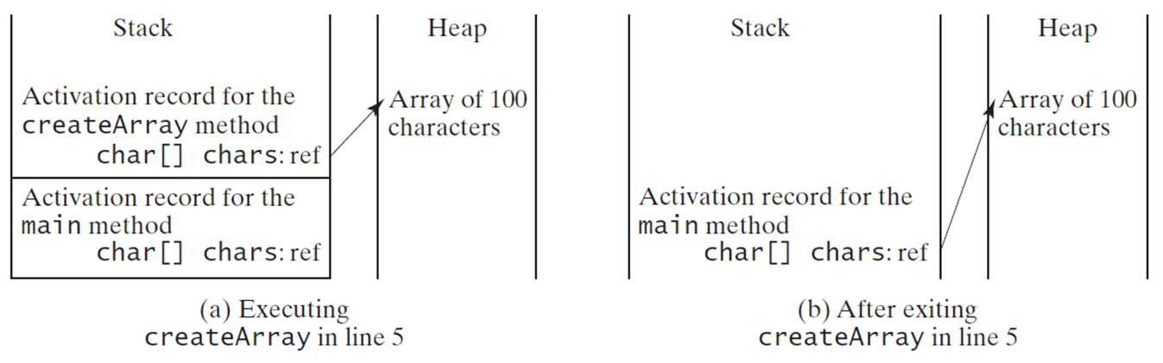
Problem: Counting Occurrence of Each Letter
Generate 100 lowercase letters randomly and assign to an array of characters.
Count the occurrence of each letter in the array.
CountLettersInArray
Notes:
Column 1. Stack. It is divided into two parts. The upper part consists of Activation record for the create Array method char open and close brackets chars, ref. The lower part consists of Activation record for the main method char open and close brackets chars, ref. Text below this column reads, Executing create Array in line 5.
Column 2. Heap. Array of 100 characters. An arrow points from chars, ref in the upper part of Stack to Array of 100 characters in Heap column.
Column 3. Stack. Activation record for the main method char open and close brackets chars, ref. An arrow points from chars, ref in this column to Array of 100 characters in the last column, titled Heap. Text below the Stack column reads, After exiting create Array in line 5.
Column 4. Heap. The text reads, Array of 100 characters.
CountLettersInArray: https://liveexample.pearsoncmg.com/html/CountLettersInArray.html

Slide 52
Variable-Length Arguments
You can pass a variable number of arguments of the same type to a method.
VarArgsDemo
Notes:
VarArgsDemo: https://liveexample.pearsoncmg.com/html/VarArgsDemo.html

Slide 53
Searching Arrays
Searching is the process of looking for a specific element in an array; for example, discovering whether a certain score is included in a list of scores. Searching is a common task in computer programming. There are many algorithms and data structures devoted to searching. In this section, two commonly used approaches are discussed, linear search and binary search.
Notes:
public class Linear Search open brace
backslash double asterisk The method for finding a key in the list asterisk backslash
public static int linear Search open parenthesis int open and close brackets list, int key close parenthesis open brace
for open parenthesis int i = 0; i less than list. Length; i plus plus close parenthesis
if open parenthesis key equal to list open bracket i close bracket close parenthesis return i; return negative 1; close brace, close brace.
for open parenthesis int i = 0; i less than list. Length; i plus plus close parenthesis is highlighted
A row labeled list is divided into multiple columns. The first three cells are labeled as open bracket 0 close bracket, open bracket 1 close bracket, open bracket 2 close bracket, ellipses.
A key below the row reads, Compare key with list open bracket i close bracket for i = 0, 1, ellipses.

Slide 54
Linear Search
The linear search approach compares the key element, key, sequentially with each element in the array list. The method continues to do so until the key matches an element in the list or the list is exhausted without a match being found. If a match is made, the linear search returns the index of the element in the array that matches the key.
If no match is found, the search returns

Slide 55
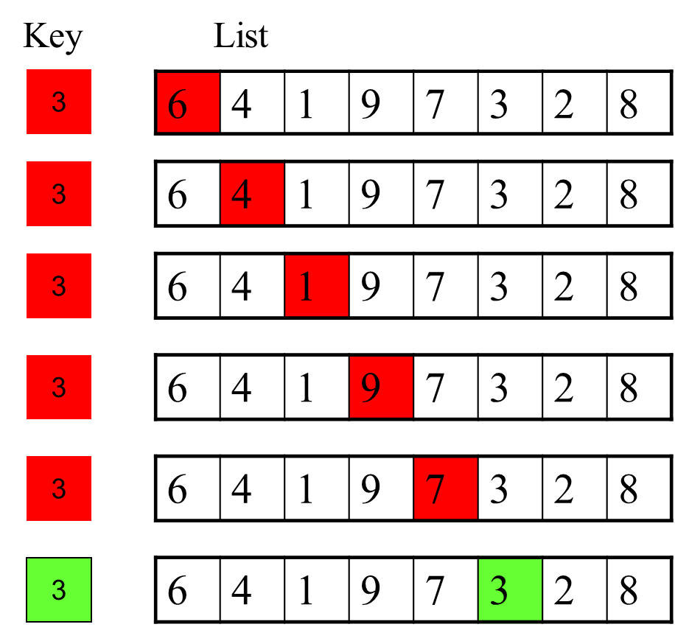
Linear Search Animation (1 of 2)
Notes:
Row 1. Key, 3 highlighted in red. List, 6, 4, 1, 9, 7, 3, 2, 8. 6 is highlighted in red.
Row 2. Key, 3 highlighted in red. List, 6, 4, 1, 9, 7, 3, 2, 8. 4 is highlighted in red.
Row 3. Key, 3 highlighted in red. List, 6, 4, 1, 9, 7, 3, 2, 8. 1 is highlighted in red.
Row 4. Key, 3 highlighted in red. List, 6, 4, 1, 9, 7, 3, 2, 8. 9 is highlighted in red.
Row 5. Key, 3 highlighted in red. List, 6, 4, 1, 9, 7, 3, 2, 8. 7 is highlighted in red.
Row 6. Key, 3 highlighted in green. List, 6, 4, 1, 9, 7, 3, 2, 8. 3 is highlighted in green.

Slide 56
Binary Search (1 of 6)
For binary search to work, the elements in the array must already be ordered. Without loss of generality, assume that the array is in ascending order.
e.g., 2 4 7 10 11 45 50 59 60 66 69 70 79
The binary search first compares the key with the element in the middle of the array.

Slide 57
Binary Search (2 of 6)
Consider the following three cases:
If the key is less than the middle element, you only need to search the key in the first half of the array.
If the key is equal to the middle element, the search ends with a match.
If the key is greater than the middle element, you only need to search the key in the second half of the array.

Slide 58
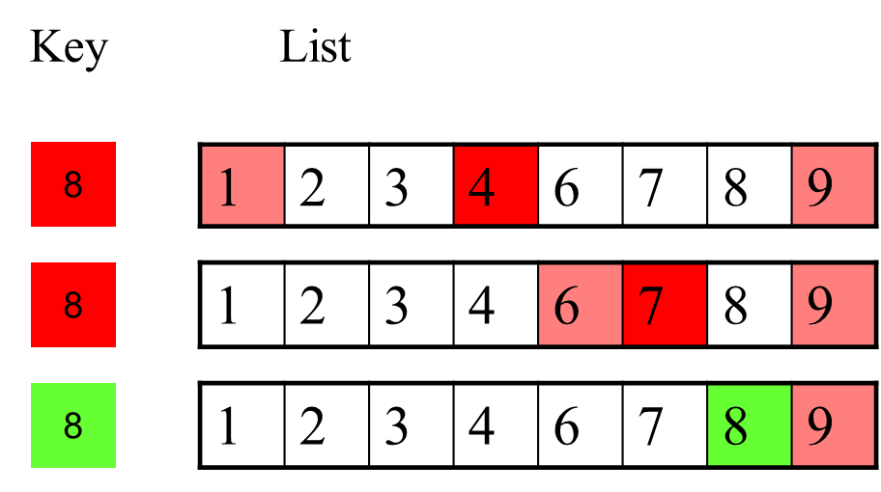
Binary Search (3 of 6)
Notes:
Row 1. Key, 8 highlighted in red. List, 1, 2, 3, 4, 6, 7, 8, 9. 4 is highlighted in red. 1 and 9 are highlighted in pink.
Row 2. Key, 8 highlighted in red. List, 1, 2, 3, 4, 6, 7, 8, 9. 7 is highlighted in red. 6 and 9 are highlighted in pink.
Row 3. Key, 8 highlighted in green. List, 1, 2, 3, 4, 6, 7, 8, 9. 8 is highlighted in green. 9 is highlighted in pink.

Slide 59
Binary Search Animation
https://liveexample.pearsoncmg.com/dsanimation/BinarySearcheBook.html

Slide 60
Binary Search (6 of 6)
The binarySearch method returns the index of the element in the list that matches the search key if it is contained in the list. Otherwise, it returns
-insertion point - 1.
The insertion point is the point at which the key would be inserted into the list.

Slide 61
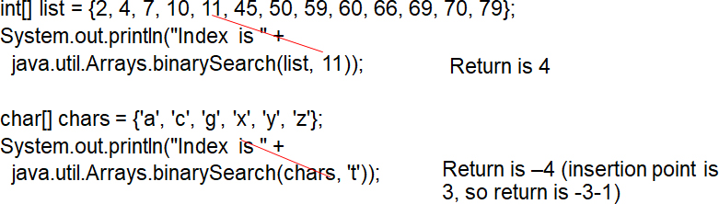
The Arrays.binarySearch Method
Since binary search is frequently used in programming, Java provides several overloaded binarySearch methods for searching a key in an array of int, double, char, short, long, and float in the java.util.Arrays class. For example, the following code searches the keys in an array of numbers and an array of characters.
For the binarySearch method to work, the array must be pre-sorted in increasing order.
Notes:
Another line shows the text, java.util.Arrays.binary Search open parenthesis list, 11 close parenthesis, close parenthesis. 11 in the int list and 11 here are connected to each other.
Another set shows char open and close brackets chars = open brace a, c, g, x, y, z close brace. All the alphabets are in single quotes. The last line of this set reads java.util.Arrays.binarySearch open parenthesis chars, t with single quotes close parenthesis close parenthesis. x in char chars is connected to t here.

Slide 62
Sorting Arrays
Sorting, like searching, is also a common task in computer programming. Many different algorithms have been developed for sorting. This section introduces a simple, intuitive sorting algorithms: selection sort.

Slide 63
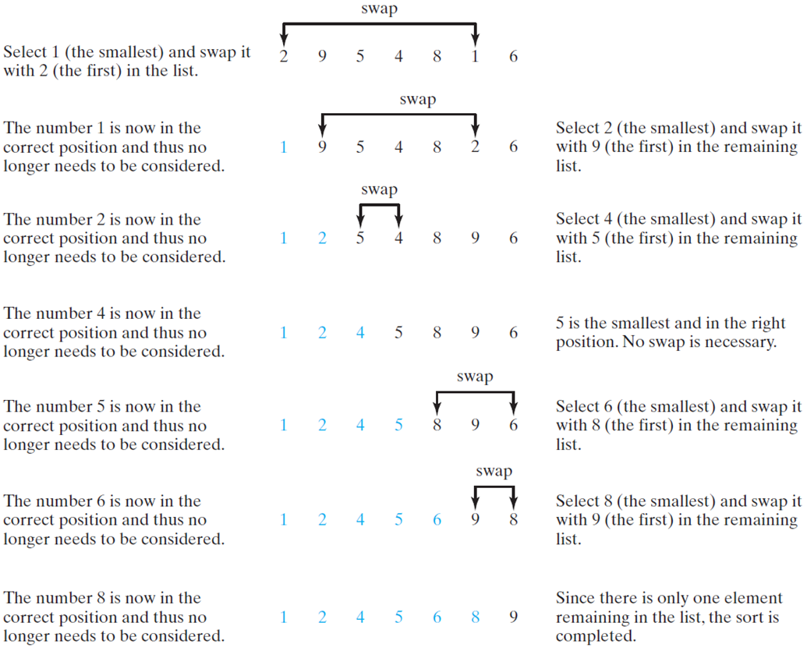
Selection Sort
Selection sort finds the smallest number in the list and places it first. It then finds the smallest number remaining and places it second, and so on until the list contains only a single number.
Notes:
Row 1. Select 1 (the smallest) and swap it with 2 (the first) in the list. The numbers in the second column are 2, 9, 5, 4, 8, 1, 6. All the numbers are in same color. A double sided arrow points between 2 and 1. The arrow is labeled swap. Third column is blank in this row.
Row 2. The number 1 is now in the correct position and thus no longer needs to be considered. The numbers in the second column are 1, 9, 5, 4, 8, 2, 6. All the numbers except 1 are of the same color. A double sided arrow points between 9 and 2. The arrow is labeled swap. Text in third column reads, Select 2 (the smallest) and swap it with 9 (the first) in the remaining list.
Row 3. The text reads, The number 2 is now in the correct position and thus has no longer needs to be considered. The numbers in the second column are 1, 2, 5, 4, 8, 9, 6. All the numbers except 1 and 2 are of same color. A double-sided arrow labeled swap connects 5 and 4. Text in the third column reads, Select 4 (the smallest) and swap it with 5 (the first) in the remaining list.
Row 4. Text reads, The number 4 is now in the correct position and thus no longer needs to be considered. The numbers in the second column are 1, 2, 4, 5, 8, 9, 6. All the numbers except 1, 2, and 4 are of the same color. Text in the third column reads, 5 is the smallest and in the right position. No swap is necessary.
Row 5. Text reads, The number 5 is now in the correct position and thus no longer needs to be considered. The numbers in the second column are 1, 2, 4, 5, 8, 9, 6. All numbers except 1, 2, 4, and 5 are of the same color. A double sided arrow labeled swap points to 8 and 6. Text in the third column reads, Select 6 (the smallest) and swap it with 8 (the first) in the remaining list.
Row 6. Text reads, The number 6 is now in the correct position and thus no longer needs to be considered. The numbers in the second column are 1, 2, 4, 5, 6, 9, 8. All the numbers except 1, 2, 4, 5, 6 are of the same color. A double side arrow labeled swap points to 9 and 8. Text in the third column reads, Select 8 (the smallest) and swap it with 9 (the first) in the remaining list.
Row 7. Text reads, The number 8 is now in the correct position and thus no longer needs to be considered. The numbers in the second column are 3, 2, 4, 5, 6, 8, 9. All the numbers except 9 are of the same color. Text in the third column reads, Since there is only one element remaining in the list, the sort is completed.

Slide 64
Selection Sort Animation
https://liveexample.pearsoncmg.com/dsanimation/SelectionSortNew.html

Slide 65
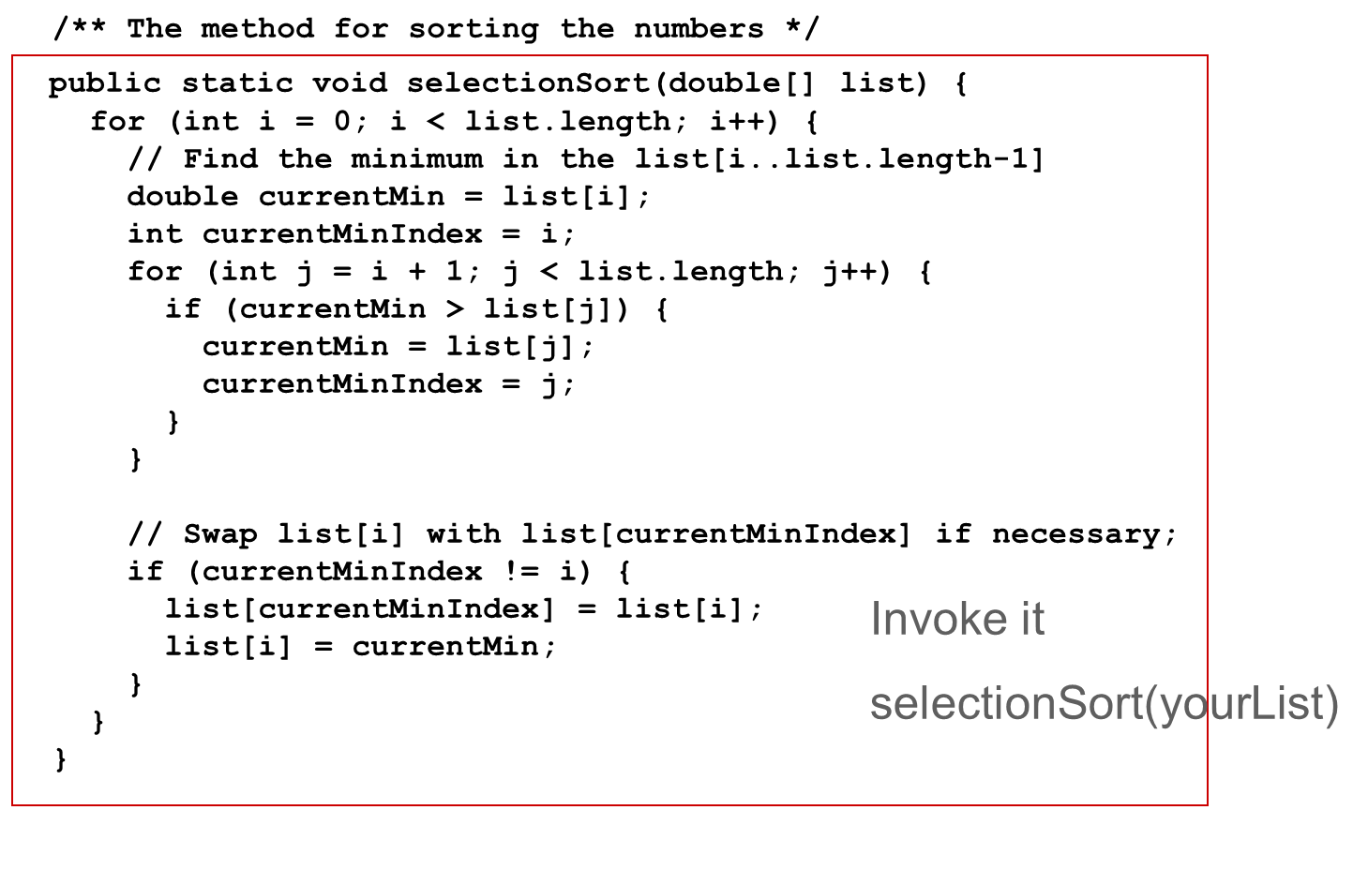
Wrap it in a Method
Notes:
public static void selectionSort left parenthesis double left bracket right bracket list right parenthesis {
for left parenthesis int i = 0 semi colon i is less than list.length semi colon i++ right parenthesis left brace
forward slash forward slash Find the minimum in the list left bracket I list.length minus 1 right brace
double currentMin = list left bracket i right bracket semi colon
int currentMinIndex = i semi colon
for left parenthesis int j = i + 1 semi colon j is less list.length semi colon j++ right parenthesis right brace
if left parenthesis currentMin is greater than list left bracket j right bracket right parenthesis left brace
currentMin = list left bracket j right bracket semi colon
currentMinIndex = j semi colon
right brace
right brace
forward slash forward slash Swap list left bracket i right bracket with list left bracket currentMinIndex right bracket if necessary semi colon
if left parenthesis currentMinIndex mark of exclamation = i right parenthesis left brace
list left bracket currentMinIndex right bracket = list left bracket i right bracket semi colon
list left bracket i right bracket = currentMin semi colon
right brace
right brace
right brace
Invoke it selectionSort left parenthesis yourList right parenthesis

Slide 66
The Arrays.sort Method
Since sorting is frequently used in programming, Java provides several overloaded sort methods for sorting an array of int, double, char, short, long, and float in the java.util.Arrays class. For example, the following code sorts an array of numbers and an array of characters.
double[] numbers = {6.0, 4.4, 1.9, 2.9, 3.4, 3.5};
java.util.Arrays.sort(numbers);
char[] chars = {'a', 'A', '4', 'F', 'D', 'P'};
java.util.Arrays.sort(chars);
Java 8 now provides Arrays.parallelSort(list) that utilizes the multicore for fast sorting.

Slide 67
The Arrays.toString(list) Method
The Arrays.toString(list) method can be used to return a string representation for the list.

Slide 68
Main Method Is Just a Regular Method
You can call a regular method by passing actual parameters. Can you pass arguments to main? Of course, yes. For example, the main method in class B is invoked by a method in A, as shown below:
Notes:
public class A open brace
public static void main open parenthesis string open and close brackets args close parenthesis open brace string open and close brackets strings = open brace open double quotes New York close double quotes, open double quotes Boston close double quotes, open double quotes Atlanta close double quotes close brace; B. main open parenthesis strings close parenthesis. close brace close brace. B. main open parenthesis strings close parenthesis is highlighted.
class B open brace public static void main open parenthesis String open and close brackets args close parenthesis open brace for open parenthesis int i = 0; i less than args. Length; i plus plus close parenthesis system. out. printIn open parenthesis args open bracket i close bracket close parenthesis; close brace close brace. public static void main open parenthesis String open and close brackets args close parenthesis is highlighted.

Slide 69
Command-Line Parameters
class TestMain {
public static void main(String[] args) {
...
}
}
java TestMain arg0 arg1 arg2 ... argn

Slide 70
Processing Command-Line Parameters
In the main method, get the arguments from args[0], args[1], ..., args[n], which corresponds to arg0, arg1, ..., argn in the command line.
Notes:
Example 12.4

Slide 71
Problem: Calculator
Objective: Write a program that will perform binary operations on integers. The program receives three parameters: an operator and two integers.
java Calculator 2 + 3
java Calculator
java Calculator
java Calculator 2.3
Calculator
Notes:
Calculator: https://liveexample.pearsoncmg.com/html/Calculator.html

